Slide 1
Building Workplace Confidence: From Self-Doubt to Self-Trust
In today's high-pressure professional environments, confidence isn't just a personal asset—it's a career-defining quality that influences everything from daily interactions to major career milestones.
The key to developing and cultivating authentic confidence in the workplace lies in moving beyond quick fixes and addressing the root causes of self-doubt. Whether you're seeking career advancement or simply wanting to feel more comfortable in your professional skin, using evidence-based techniques will empower you to show up as your most confident self.
by LENA MILIONI

Slide 2
Understanding Self-Esteem and Self-Worth
Self-esteem and self-worth form the foundation of workplace confidence. While self-esteem reflects how we evaluate our abilities and performance, self-worth encompasses our inherent value as human beings regardless of achievements.
These internal beliefs significantly impact our professional lives, affecting everything from how we communicate ideas to whether we pursue promotions. Many professionals struggle to separate their worth from their work, leading to validation-seeking behaviours that undermine genuine confidence.
Workplace confidence is the ability to trust your skills, judgement and capabilities in professional settings. It involves recognising your value whilst acknowledging areas for growth without harsh self-criticism. Building healthy self-esteem requires recognising your intrinsic value whilst acknowledging that performance fluctuates naturally throughout your career journey.
Self-Actualisation
Fulfilling potential and purpose
Self-Esteem
Evaluative judgements of abilities
Self-Worth
Inherent value as a human being

Slide 3
The Confidence Gap: Internal vs. External Experience
Internal Experience
External Perception
What we feel inside often includes uncertainty, self-doubt, and awareness of our own flaws and shortcomings. We experience our fears, insecurities and the full complexity of our thoughts.
What others see is typically a more polished, capable version of ourselves. They lack access to our internal doubts and instead observe our competencies, successes and composed exterior.
Full access to private worries, fears and doubts
No access to our private thoughts
Awareness of past mistakes and failures
Greater awareness of our strengths
Heightened sensitivity to potential rejection
Perception filtered through their own insecurities
Overestimation of personal inadequacies
Assumption of greater confidence than we feel
This disconnect between how we feel internally and how others perceive us creates the "confidence gap." Understanding this gap helps us realise that feeling uncertain doesn't mean we appear that way to others. Confidence isn't about eliminating doubt but about acting purposefully despite it.

Slide 4
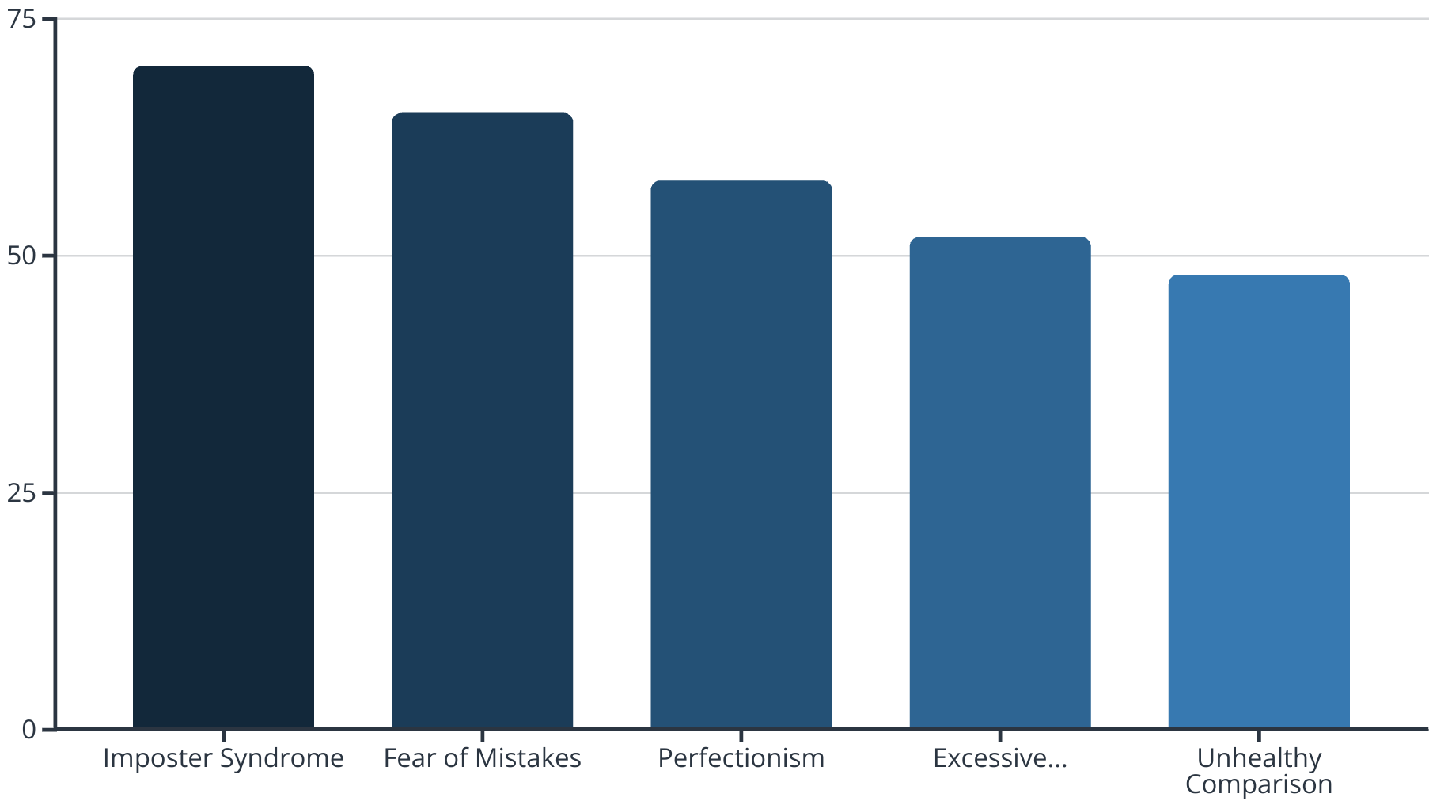
Common Confidence Obstacles in the Workplace
Many professionals encounter significant barriers to confidence development. The fear of making mistakes often leads to hesitancy and missed opportunities. This combines with the overwhelming desire to be universally liked, causing people to suppress honest opinions and authentic self-expression.
Working excessive hours frequently stems from a need to prove one's worth, while constant comparison with colleagues creates an unproductive mental treadmill of inadequacy. These patterns gradually erode self-trust and increase susceptibility to imposter syndrome—the persistent feeling of being a fraud despite evidence of competence.
Recognising these patterns is the crucial first step toward developing sustainable confidence strategies.

Slide 5
Overcoming Perfectionism and Imposter Syndrome
Perfectionism and imposter syndrome create a debilitating cycle in professional settings. The relentless pursuit of flawlessness sets impossible standards, whilst imposter syndrome whispers that any success is merely luck or deception that will eventually be exposed.
This toxic combination leads to decision fatigue as professionals overthink choices, fearing the consequences of any imperfection. Breaking free requires recognising that mistakes are essential learning opportunities and that competence develops through practice rather than appearing fully-formed.
By embracing a growth mindset, you can transform these internal critics into constructive guides for continuous improvement rather than obstacles to confidence.
Feeling Like a Fraud
Overworking
Dismissing accomplishments as luck
Excessive preparation to avoid failure
Burnout
Setting Impossible Standards
Exhaustion reinforcing self-doubt
Creating unachievable benchmarks

Slide 6
Silencing Your Inner Critic
The inner critic operates as an internal saboteur, undermining confidence through persistent negative self-talk. This critical voice often originates from internalised external judgements and past experiences, becoming so familiar that many people mistake it for objective reality.
Transforming this relationship begins with identification—recognising when criticism becomes unhelpful rumination rather than constructive feedback. By understanding these patterns, you can replace destructive thoughts with balanced perspectives that acknowledge both strengths and growth areas.
Self-compassion plays a crucial role in this transformation, allowing professionals to treat themselves with the same kindness they would offer colleagues facing similar challenges.
Identify Critic
Challenge Validity
Reframe Narratives
Practice Compassion
Recognise negative thought patterns Notice when your inner voice becomes harsh, judgemental or catastrophic. Pay attention to absolutist language like "always," "never," or "I have to/ need to…"
Question evidence supporting criticisms. Ask yourself: " Is it a fact or my opinion? What evidence contradicts it? Would I speak this way to someone I care about?"
Create balanced thought alternatives that acknowledge both challenges and strengths
Respond with self-kindness

Slide 7
Building Self-Compassion: The Cornerstone of Authentic Confidence
Self-Compassion
Treating yourself with the same kindness you would offer a good friend
Common Human Experiences
Recognising that imperfection is part of the shared human experience
Mindful Awareness
Observing thoughts and feelings without judgement or suppression
Self-compassion forms the foundation for sustainable confidence. Unlike confidence built solely on achievement, self-compassion provides a stable base that remains even when you face setbacks. By treating yourself with kindness during difficult moments, you create psychological safety that allows for authentic growth and resilience.
Remember that confidence is a practice rather than a destination. Through continued self-awareness, compassionate self-correction, and consistent action, you can cultivate a genuine sense of workplace confidence that emanates from within rather than depending on external validation.

Slide 8
Practical Tools for Boundary Setting and Assertiveness
Confidence in the workplace manifests through clear boundaries and assertive communication. Many professionals struggle with saying "no" or expressing needs directly, fearing negative perceptions or relationship damage. However, healthy boundaries actually strengthen professional relationships by establishing mutual respect.
Assertiveness involves expressing opinions and needs clearly without aggression or apology. This skill can be cultivated through specific language techniques, such as using "I" statements and avoiding unnecessary qualifiers that undermine your message.
Regular practice of these skills gradually builds confidence in your right to occupy professional space authentically, transforming workplace interactions.
Identify Your Non-Negotiables
Practice Direct Communication
Determine your core values and limits before situations arise, making it easier to respond confidently when boundaries are tested.
Use clear, concise language without apologetic preambles when expressing needs or declining requests that violate your boundaries.
Request Processing Time
Start With Small Steps
When facing unexpected requests, normalise taking time to consider rather than agreeing under pressure to please others.
Begin with lower-stakes boundary setting to build confidence before addressing more challenging situations with senior colleagues. This will help you build your confidence muscle gradually. Expand your comfort zone as confidence grows.

Slide 9
Embodying Confidence Through Presence
Physical presence significantly influences both how others perceive your confidence and how you experience it internally. Research demonstrates that body language, vocal tone, and posture create a bidirectional relationship with confidence—not only expressing it outwardly but actually generating authentic confidence from within.
The confidence gap often manifests as a disconnect between internal feelings and external presentation. Many highly competent professionals appear uncertain through unconscious physical habits like closed posture or hesitant speech patterns, undermining their actual expertise.
Practicing deliberate presence techniques creates neural pathways that gradually bridge this gap, aligning your external presentation with your internal capabilities.
Powerful Posture
Engaged Eye Contact
Purposeful Gestures
Voice modulation
Standing tall with shoulders back and spine aligned projects authority while actually triggering confidence-boosting hormonal changes.
Maintaining comfortable eye contact during conversations demonstrates security in your ideas without appearing aggressive.
Using deliberate hand movements enhances verbal communication while preventing nervous fidgeting that undermines your message.
Speak at a measured pace with deliberate pauses. Lower the pitch of your voice slightly and project from your diaphragm rather than your throat. Eliminate qualifying phrases like "I just think" or "I'm sorry, but...".

Slide 10
Integration: From Self-Doubt to Authentic Confidence
True workplace confidence integrates internal self-trust with external expression, creating authenticity that resonates with colleagues and leadership. This integration requires consciously identifying limiting beliefs and self-sabotaging patterns that keep you trapped in cycles of doubt.
By rewriting shame-based narratives into stories of growth and resilience, you transform past challenges into foundations for genuine confidence. Regular visualisation practices strengthen this integration, allowing you to mentally rehearse bringing your authentic self to professional scenarios.
Remember that confidence isn't about eliminating all doubt—it's about developing trust in your ability to navigate uncertainty with courage and integrity. As you implement these strategies, you'll create a self-reinforcing cycle where each authentic expression builds greater confidence for future challenges.
Integration
Transformation
Embody confidence holistically through regular practice, until authentic self-expression becomes your natural state rather than a conscious effort.
Awareness
Apply targeted strategies to challenge limiting beliefs, practicing new behaviours that align with your authentic professional identity.
Recognise patterns of self-doubt and their impact on your professional life, identifying specific triggers and manifestations unique to your experience.

